Slide 1
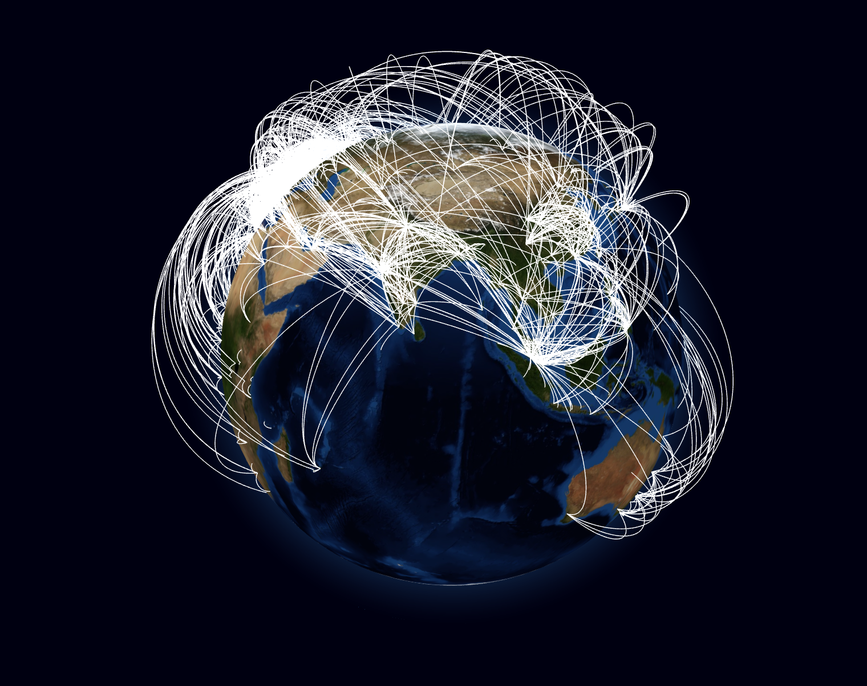
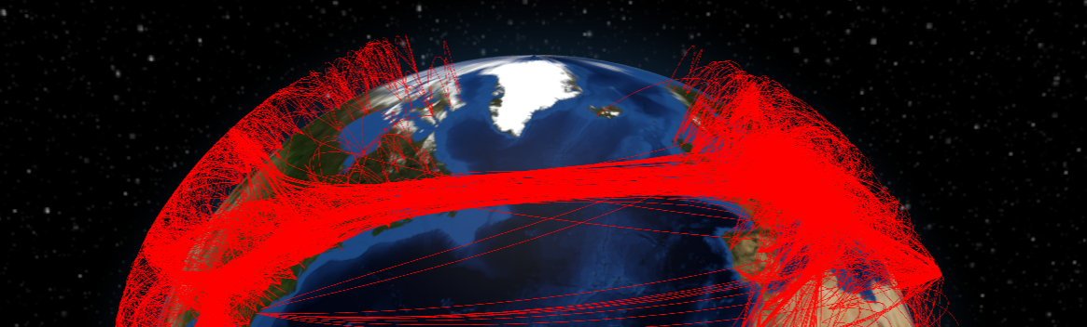
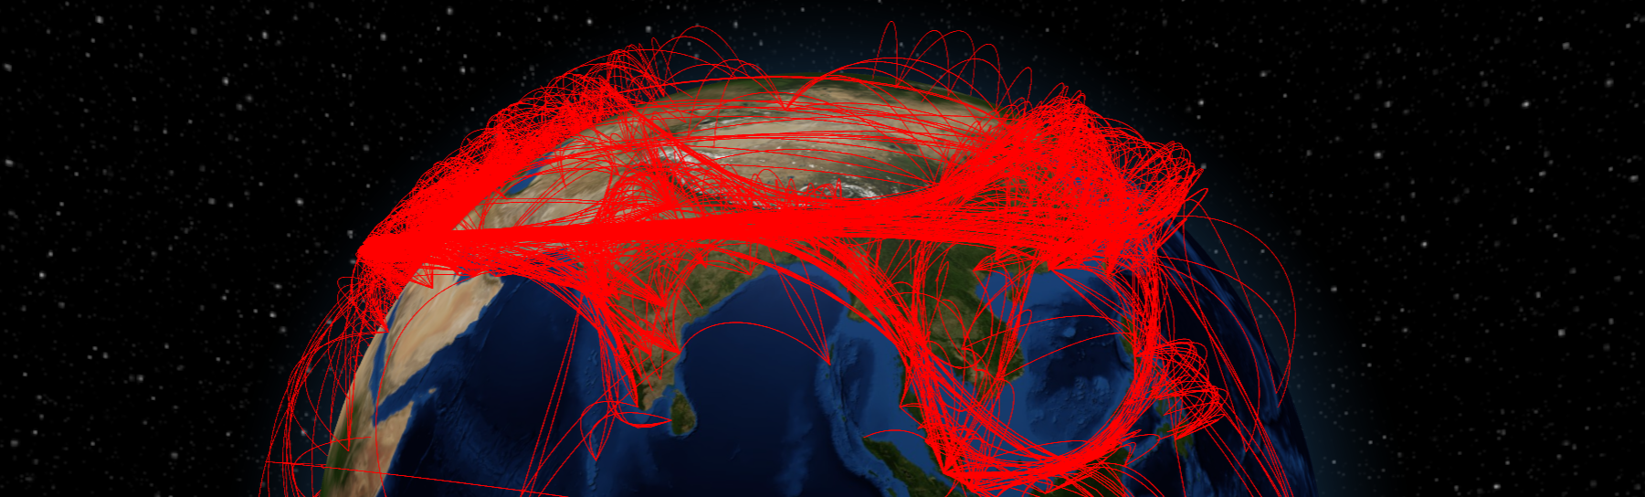
VU Visualisierung 2 (186.833) Edge-Path Bundling
Teaser image of your planned work
David Köppl 12022493, Elias Füricht 52005515
Institute of Visual Computing & Human-Centered Technology, TU Wien, Austria

Slide 2
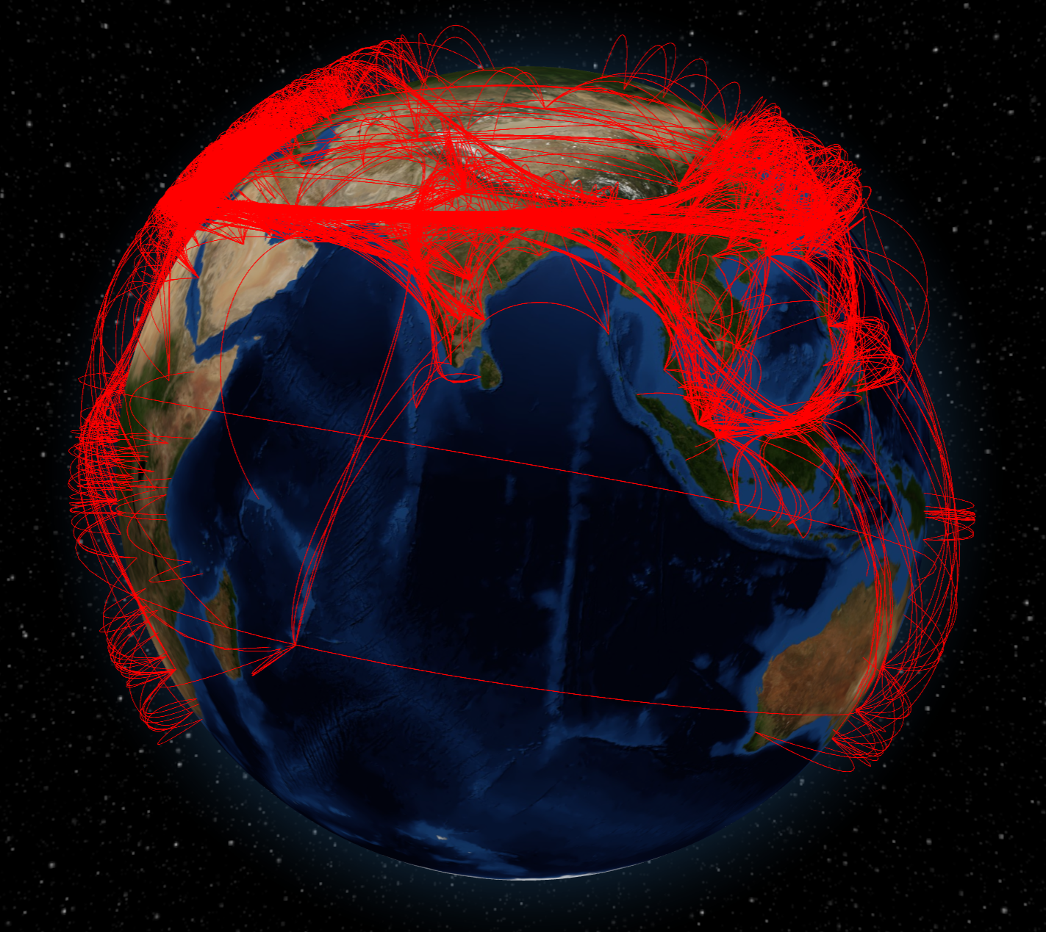
What did we do again?
Edge-Path Bundling: technique for reducing visual clutter in graphs.
Key Improvement: Mapping flight routes on the globe.
Notes:
Summarize the algorithms and concepts described in the paper.
If space is available, put some representative image here
~ 1 minute

Slide 3
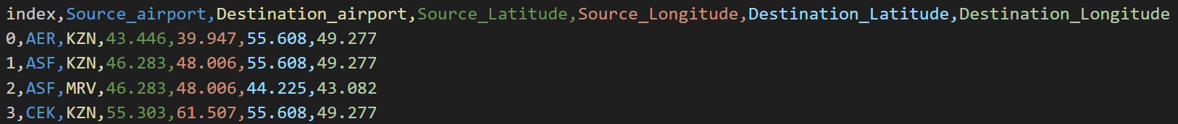
Implementation – Preprocessing
Merge datasets from Kaggle.com and openflights.org
Preprocess the data to filter out redundant connections
David Köppl, Elias Füricht
Notes:
Mapping on sphere will be tricky – challenges with shortest from e.g. Hawaii to Australia (2D Map vs Earth)

Slide 4
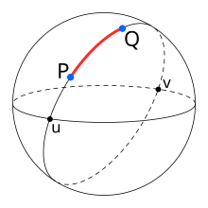
Implementation – Edge-Bundling
Construct graph from flight data
Use Haversine distance instead of
Euclidian distance for edges
Apply edge-path bundling algorithm from Wallinger et al.
Generate Bezier curves based on extracted control points
Translate segments into atmosphere according to position on curve
https://en.wikipedia.org/wiki/Haversine_formula
David Köppl, Elias Füricht
Notes:
Mapping on sphere will be tricky – challenges with shortest from e.g. Hawaii to Australia (2D Map vs Earth)

Slide 5
Implementation – Limitations
Responsive GUI
Offloading Edge-Bundling to a web worker
Browser memory limitations
Large data sets lead to “out of memory” errors
David Köppl, Elias Füricht
Notes:
Mapping on sphere will be tricky – challenges with shortest from e.g. Hawaii to Australia (2D Map vs Earth)

Slide 6

Let’s see it!

Slide 7
Wallinger et al. 2022
Markus Wallinger, Daniel Archambault, David Auber, Martin Nöllenburg, Jaakko Peltonen
Edge-Path Bundling: A Less Ambiguous Edge Bundling Approach
IEEE Transactions on Visualization & Computer Graphics, vol. 28, no. 01, pp. 313-323
2022

